Slide 1


Airbnb Price Prediction
George Janjalia
Baskar Dakshinamoorthy

Slide 2
Agenda
Introduction
Goals
Data Set
Cleansing
EDA
Model
Evaluation

Slide 3
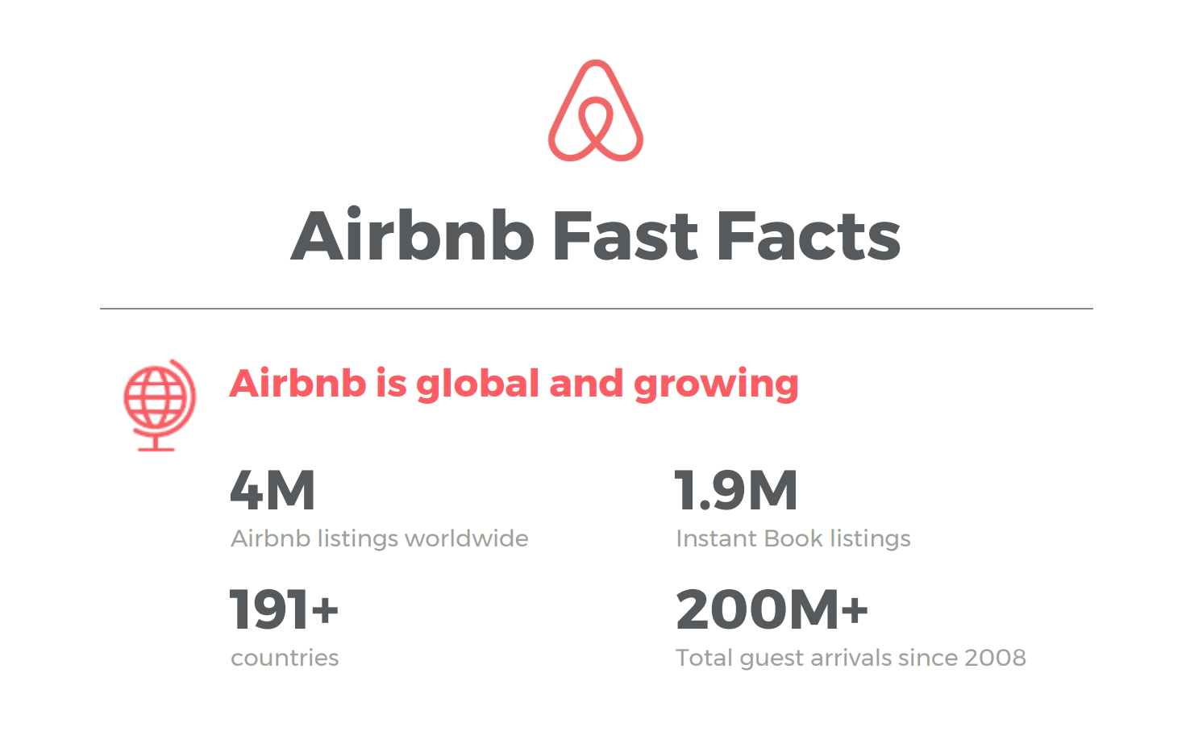

Slide 4
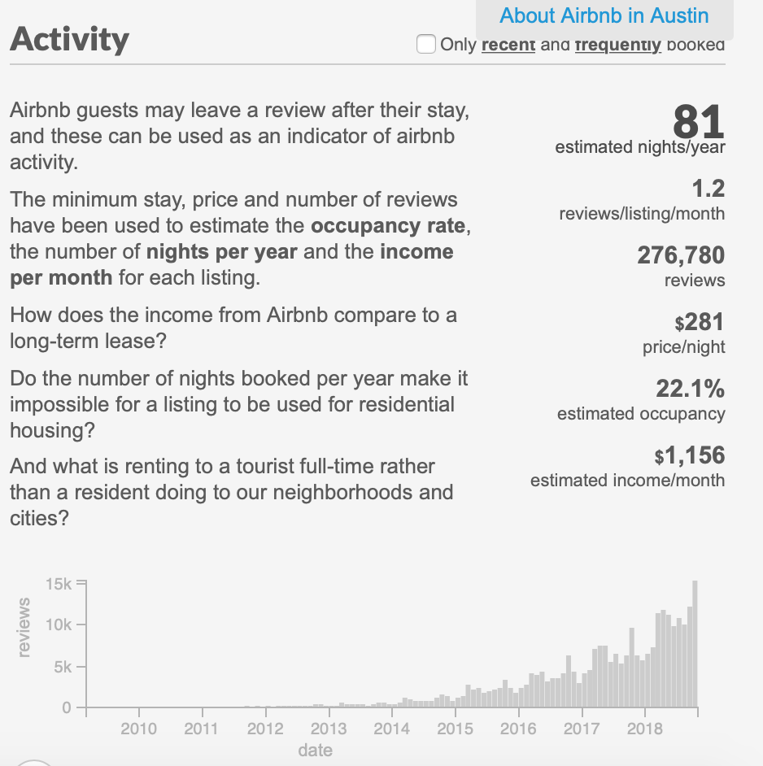
Goals & Questions
What are the positive and negative reviews (based on review text);
What are the main factors that influence Airbnb renting price;
Correlation between reviews, scores and locations vs price.

Slide 5
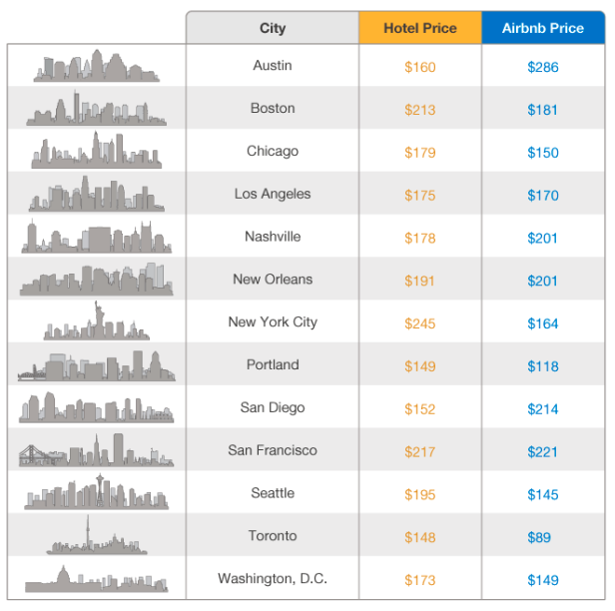
About the Data Set
Austin Airbnb Review Dataset
Listings: 11890 rows x 16 columns
Reviews: 300k rows x 6 Columns
Pre Var: Price

Slide 6
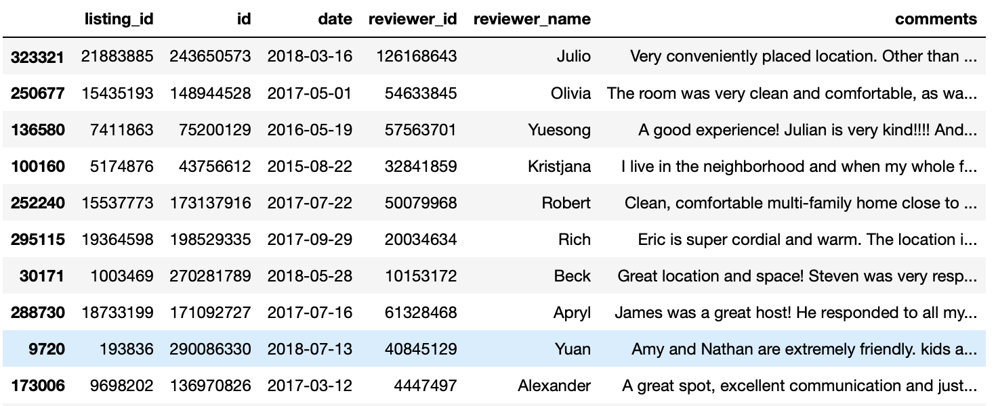
The Data Set

Slide 7
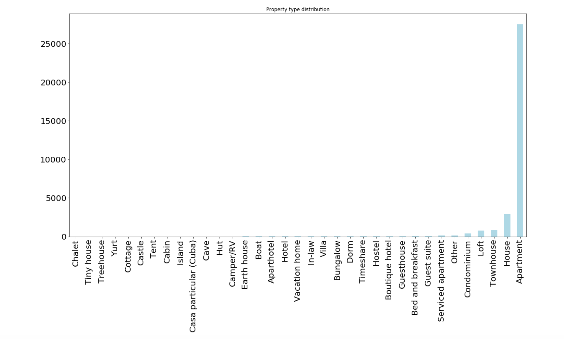
Data Cleansing
Useful Attributes
Convert CSV into text
Read in into a new file
Create for loop to strip data of all the mess
Get rid of Stopwords
Vectorize using and normalized the data
Create Train and Test sets

Slide 8
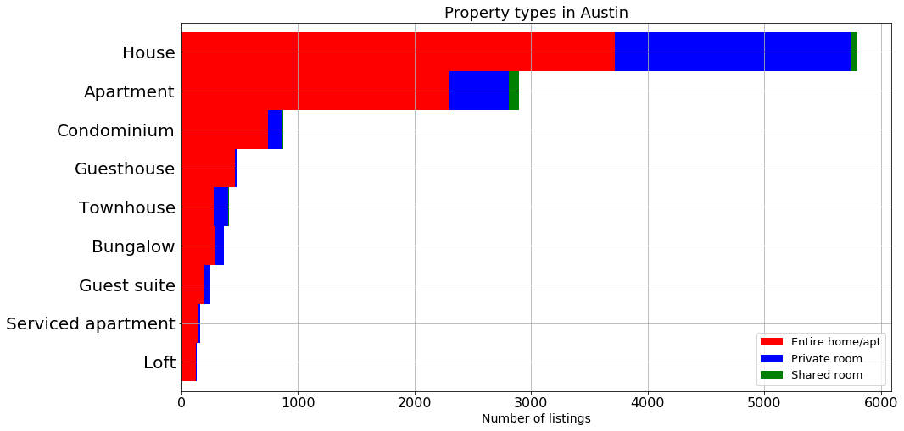
EDA
Price vs Guest Satisfaction

Slide 9
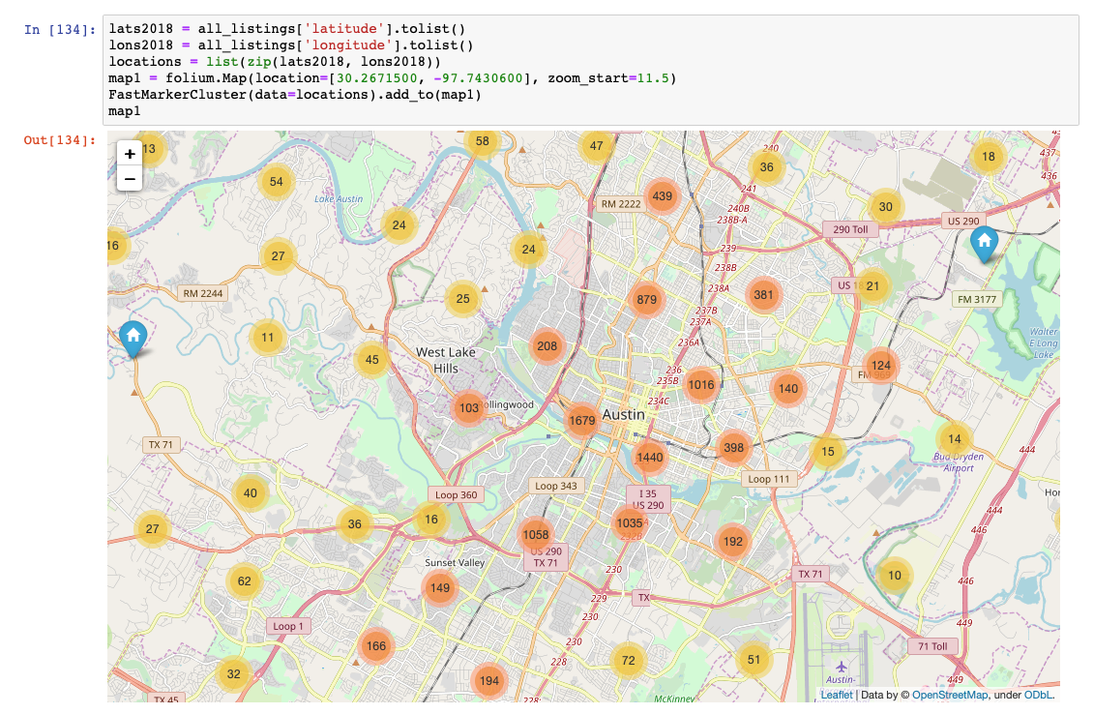

Slide 10
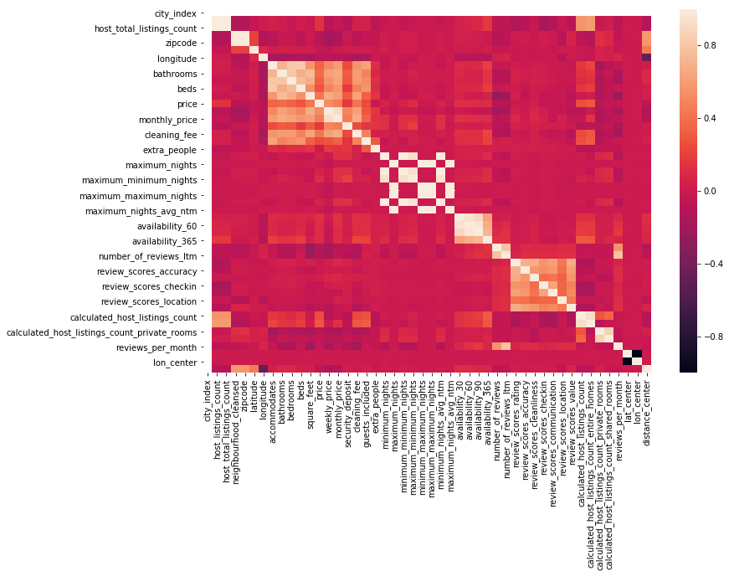

Slide 11

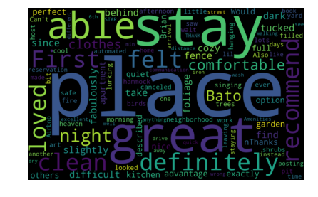
Listings
Reviews

Slide 12
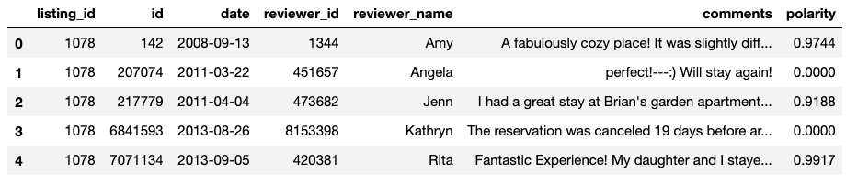
Models
Vader Sent Model – NLTK
-1 : - 0.25 – Negative
- 0.25 : 0.25 – Neutral
0.25 : 1 – Positive

Slide 13
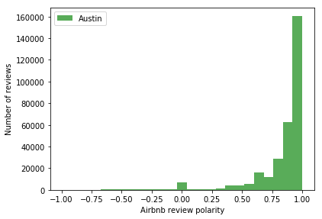
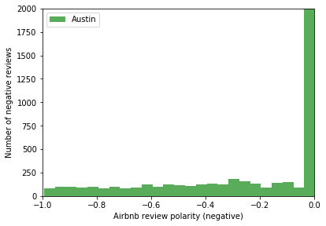
Polarity Levels

Slide 14


